Slide 1





Millimeter-Wave Vehicle-to-Infrastructure Communications for Autonomous Vehicles: Location-Aided Beam Forecasting in 6G
16th International Conference on Communication and Networks (COMSNETs 2024)
Workshop on Connected Vehicles & Autonomous Driving
Omikumar B. Makadia, Dhaval K. Patel, Kashish D. Shah, Mehul S. Raval, Mukesh Zaveri, S.N. Merchant
Presenter: Omikumar Makadia
BTech. CSE, School of Engineering and Applied Sciences
Undergraduate Researcher, Machine Intelligence, Computing and xG Networks (MICxN) Research Lab
January 7, 2023

Slide 2
Acknowledgement
The authors thank the Machine Intelligence, Computing and xG Networks (MICxN), School of Engineering and Applied Science, Ahmedabad University for providing the infrastructural support.
This work is sponsored by the University Research Board under Project Seed Grant URBSEASI22A3 and the Department of Science and Technology-Gujarat Council of Science and Technology (DST-GUJCOST) under Grant GUJCOST/STI/R&D/2023-24/3204.

Slide 3
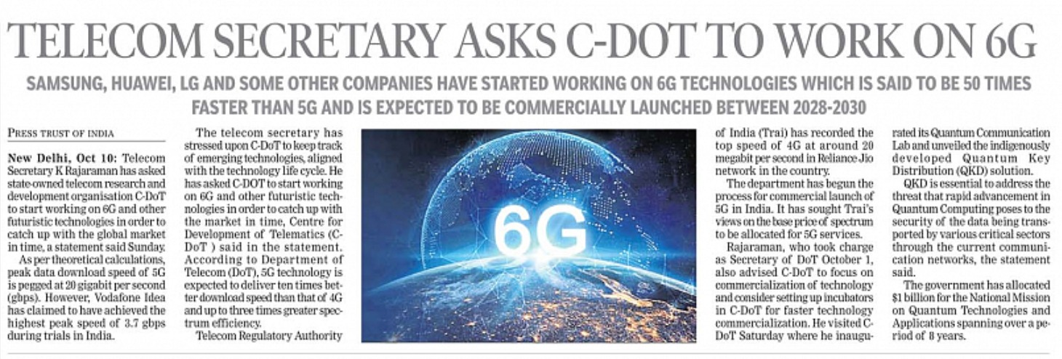
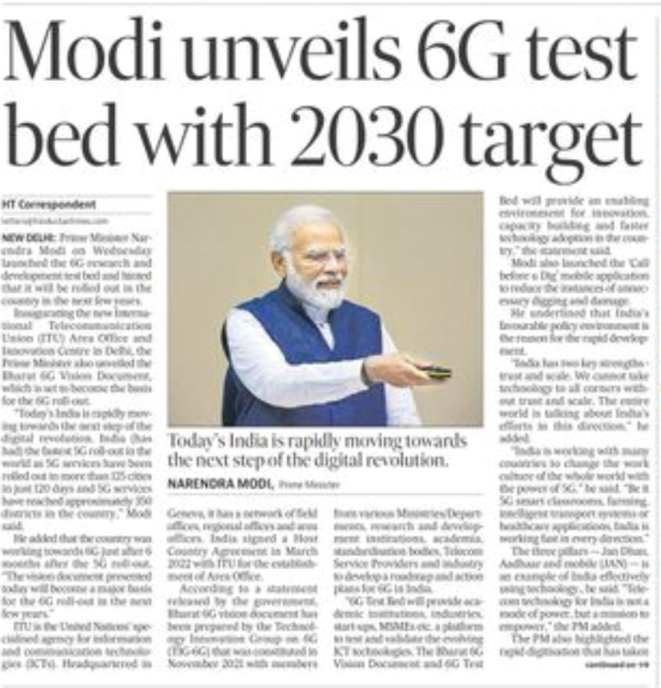
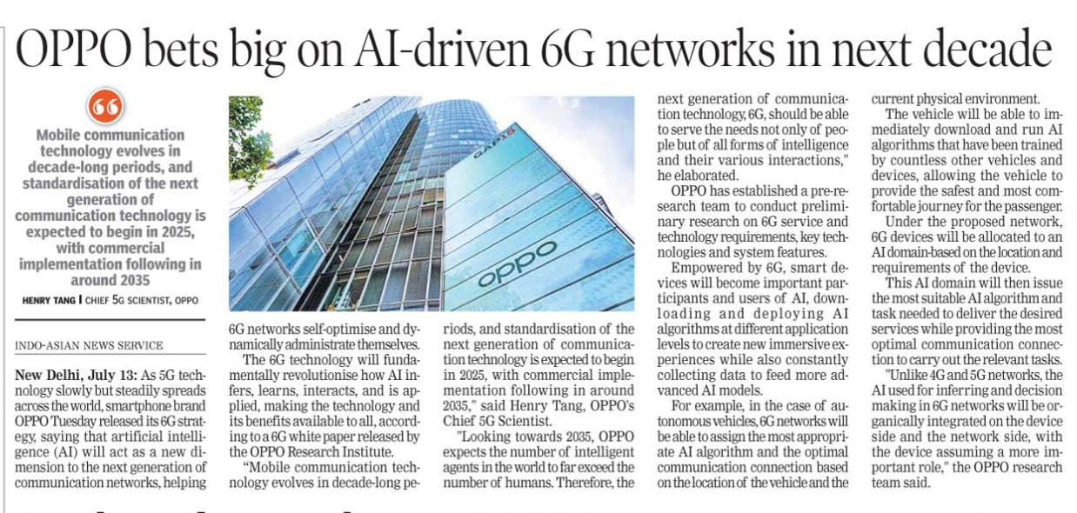
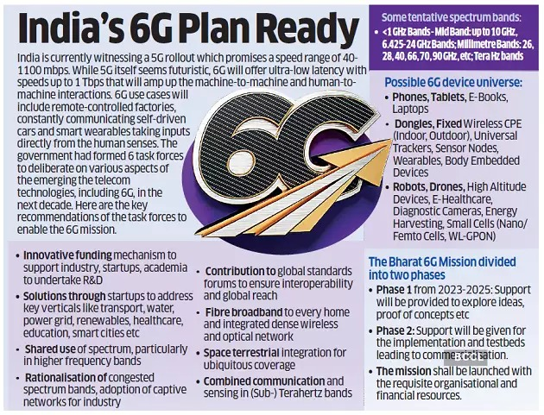
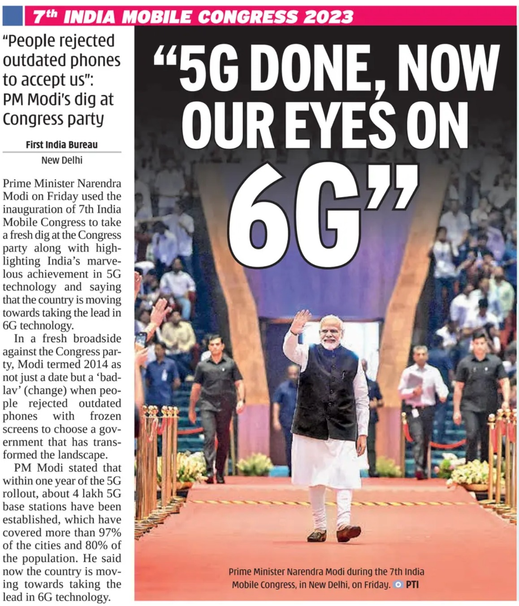


Slide 4
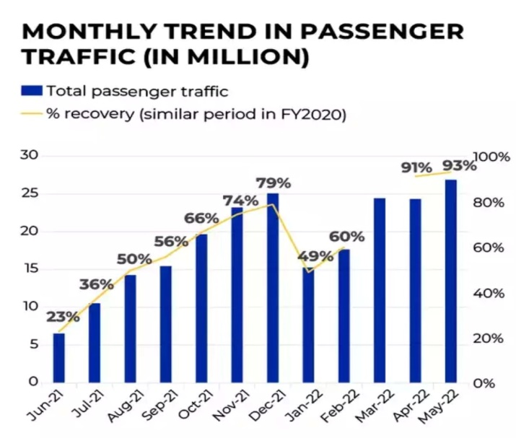
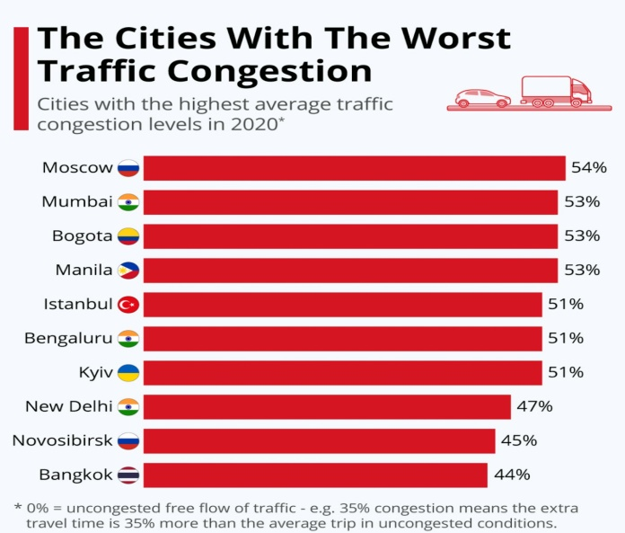
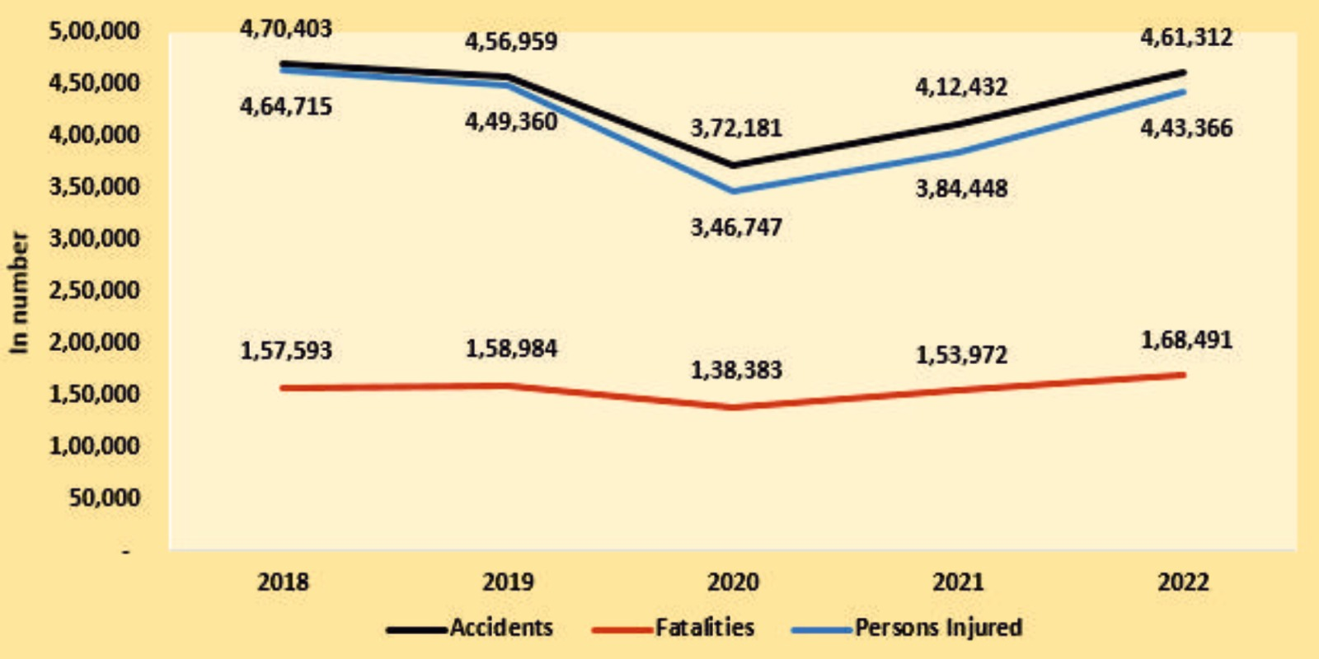
Monthly trend in passenger traffic [1]
The Cities With The Worst Traffic Congestion [2]
Number of Accidents across the years [3]
[1] TIMESOFINDIA.COM. (2022, June 7). India’s passenger traffic reaches 93% of pre-Covid levels in May 22. The Times of India. https://timesofindia.indiatimes.com/business/india-business/indias-passenger-traffic-reaches-93-of-pre-covid-levels-in-may-22/articleshow/92049177.cms
[2] McCarthy, N. (2021, January 14). The cities with the worst traffic congestion. Statista Daily Data. https://www.statista.com/chart/18281/percentage-of-extra-travel-time-due-to-congestion
[3] Ministry of Road Transport and Highways releases Annual Report on ‘Road Accidents in India-2022”. (n.d.). https://pib.gov.in/PressReleasePage.aspx?PRID=1973295#:~:text=As%20per%20the%20report%2C%20a,injuries%20to%204%2C43%2C366%20persons.

Slide 5
Introduction
Driving environment elements
Vehicles, pedestrians, emergency vehicles, motorbikes, cyclists needs to be considered.
Solution: 5G NR-V2X
Recent advances in 3GPP release 16 have started new era of road connectivity.
It offers ultra-low latency and high reliability.
WAVE ( Wireless Access in Vehicular Environments )
IEEE 802.11p WAVE systems is used for dedicated short-range communication (DSRC).
It guarantees bidirectional V2I connectivity.
In the recent 6G era, millimeter wave has been getting a lot of recognition

Slide 6
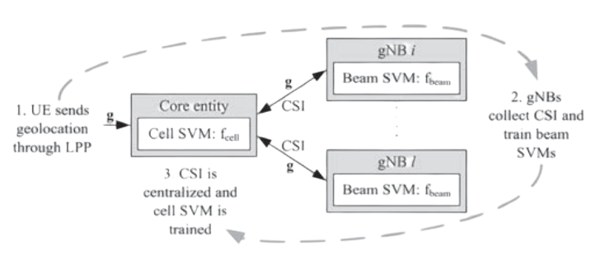
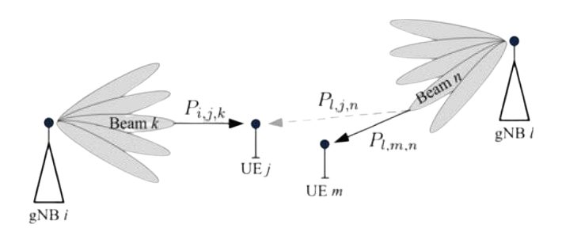
Literature Review 1/2
Three stage procedure for the SVM models [4]
Multi-cell, multiuser communication scenario [5]
This study explores how wireless communication systems work better by user positions.
The research provides a machine learning solution for enhancing beam management in 5G NR millimeter wave.
The main building block is SVMs, which are used to model the mapping between the UEs geolocations and their serving beams in a multiuser, multi-cell environment.
[4-5] Beam Management in 5G NR using Geolocation Side Information. (2019, March 1). IEEE Conference Publication | IEEE Xplore. https://ieeexplore.ieee.org/stamp/stamp.jsp?tp=&arnumber=8692820

Slide 7
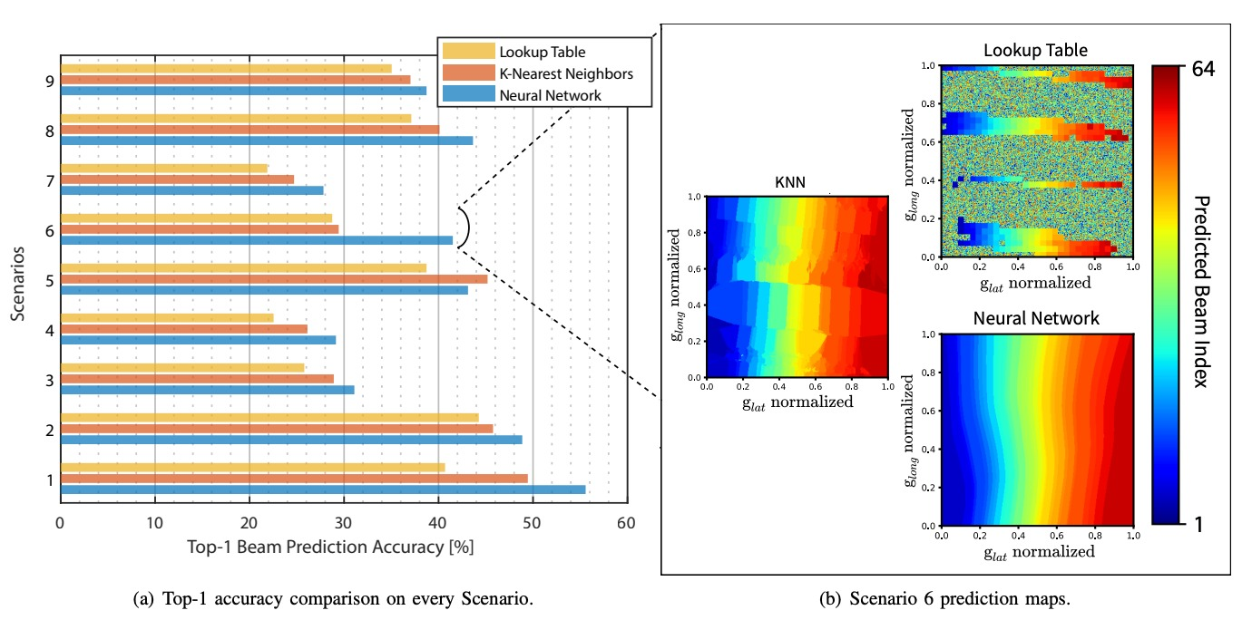
Literature Review 2/2
Accuracy of different machine learning models on DeepSense 6G dataset for position modality [6]
This study revisit the position-aided beam prediction problem in light of real-world measurements with commercial-off-the-shelf GPS
The study also derives insights into how much beam training overhead can be saved in practice.
[6] Morais, J., Behboodi, A., Pezeshki, H., & Alkhateeb, A. (2022). Position aided beam prediction in the real world: How useful GPS locations actually are? arXiv (Cornell University). https://doi.org/10.48550/arxiv.2205.09054

Slide 8
Limitations
While LT and KNN were simple choices, for NN, the input was quantized albeit reasonable granularity.
The reasons listed for low accuracies were incomplete.
The strength of preprocessed GPS coordinates as features for beam indices is not analyzed.

Slide 9
Motivation
To develop a machine learning model that can outperform the baseline models in beam prediction.
Find a way to reduce more beam training overhead.

Slide 10
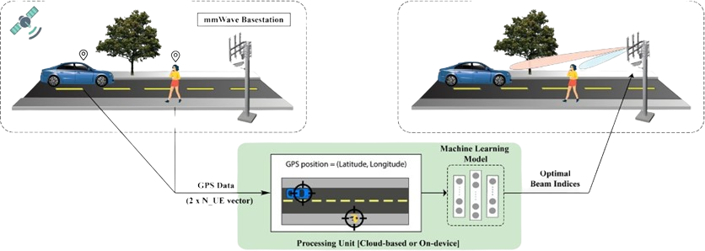
Problem Definition
Instead of relying on the explicit channel knowledge, i.e., the knowledge of 𝒉, which is hard to acquire, we target predicting the optimal beam based solely on the real-time position information of the UE. If 𝑔∈ℝ^2 denotes the two-dimensional position vector, composed of latitude 𝑔_𝑙𝑎𝑡 and longitude 𝑔_𝑙𝑜𝑛𝑔 , our problem consists in approximating 𝒇* by the estimation 𝒇 that maximizes ℙ(𝑓 ̂=𝑓* |𝑔).
Position-aided beam prediction [7]
[7] Position-Aided Beam Prediction – DeepSense. (n.d.). https://www.deepsense6g.net/position-aided-beam-prediction/

Slide 11
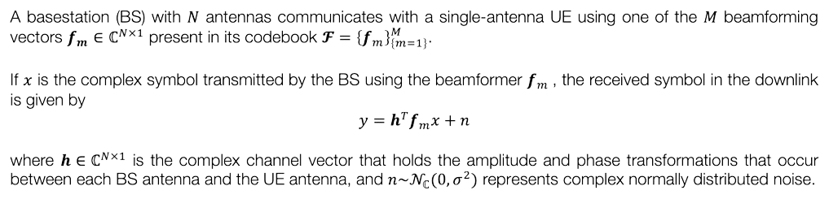
Beam Prediction System Model

Slide 12
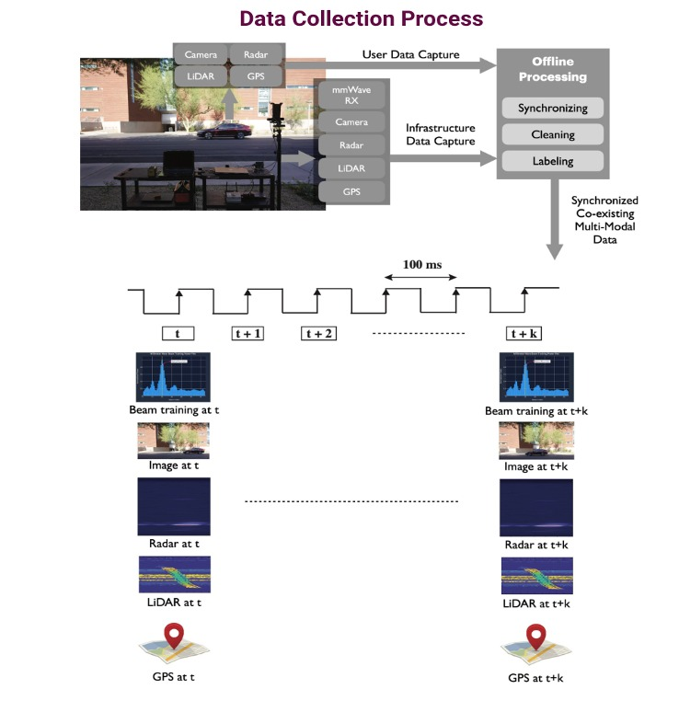

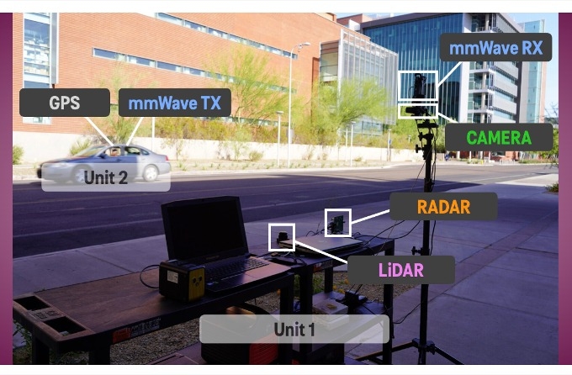
DeepSense 6G
www.deepsense6g.net
Data collection Hardware Elements [8]
Data collection Process [9]
[8-9] Data collection – DeepSense. (n.d.). https://www.deepsense6g.net/data-collection/

Slide 13
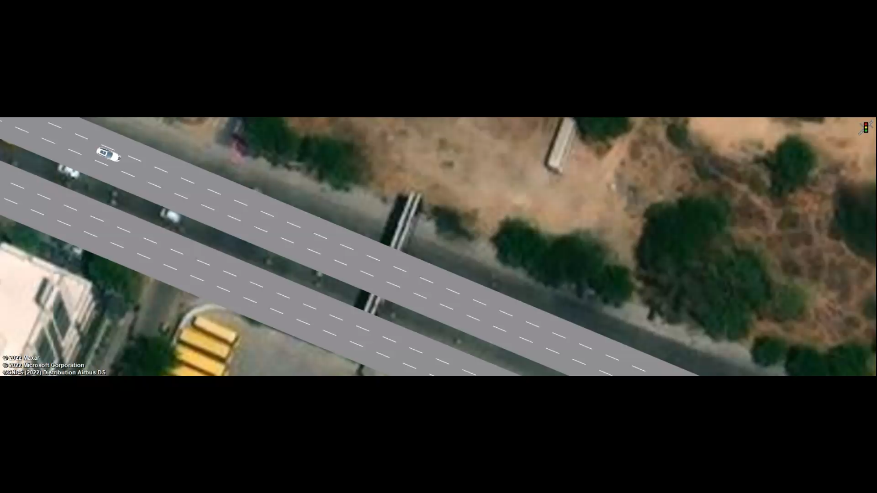
Real Time Implementation

Slide 14
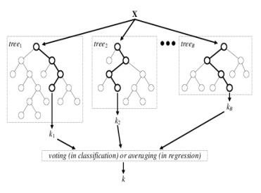
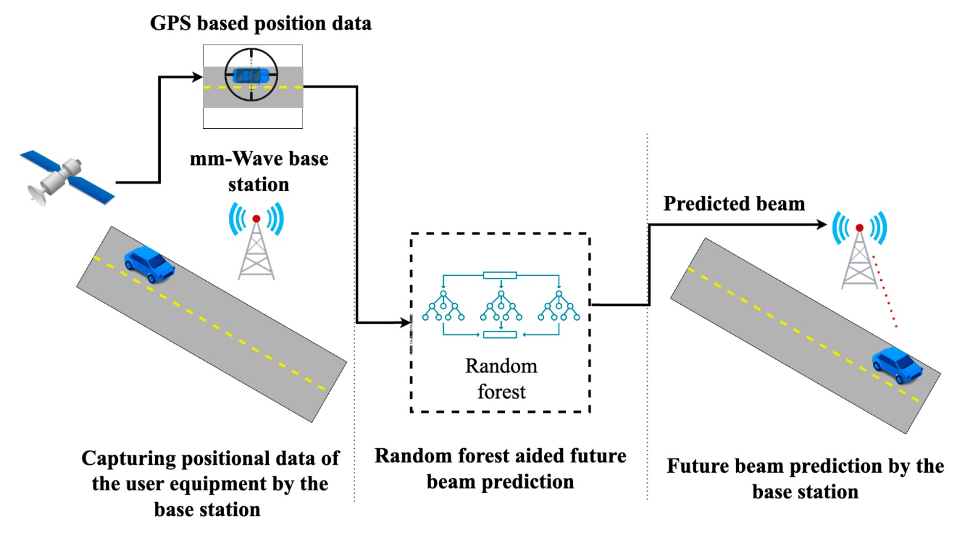
Methodology
Random forest model [10]
Proposed block diagram for future beam prediction.
[10] Figure 6. Architecture of the random forest model. (n.d.). ResearchGate. https://www.researchgate.net/figure/Architecture-of-the-random-forest-model_fig1_301638643

Slide 15
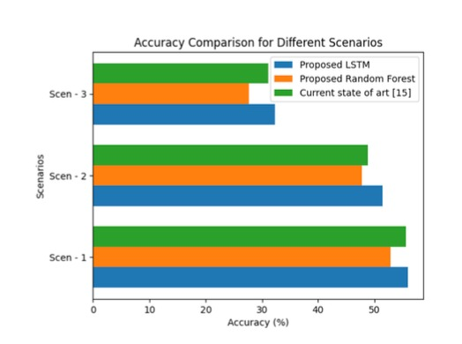
Results 1/3
Comparative analysis of hitting accuracy with the baseline of current
beams compared to the ground truth across different scenarios.
Proposed LSTM outperforms the baseline model for current beam prediction.
Beam prediction helps select the most likely sequence of outputs from a set of possibilities.
LSTM networks have been employed for beam prediction tasks due to their ability to capture sequential and long-range dependencies.

Slide 16
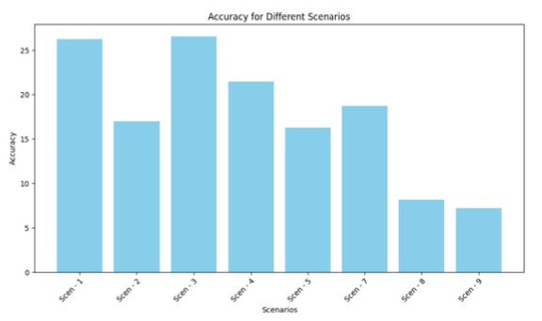
Results 2/3
Hitting accuracy of future beams compared to the ground truth across
different scenarios.
Random forest yields reasonable accuracy for future beam prediction.
We are trying to determine the optimal angles by anticipating where vehicles will be in the network.
It helps make communication more trustworthy and fast.

Slide 17
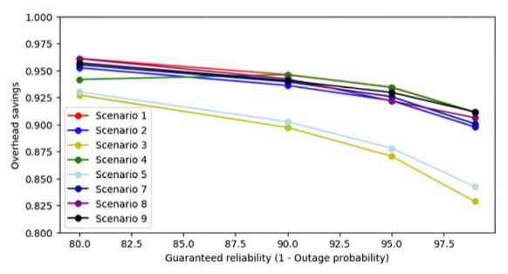
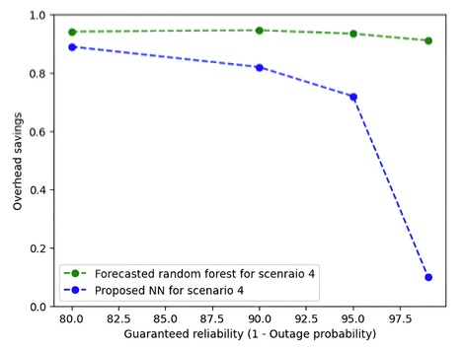
Results 3/3
Overhead savings as a function of outage probability across different scenarios.
Comparative analysis of overhead savings as a function
of outage probability with the baseline in scenario 4
Random forest excel at capturing intricate patterns within the data.
Their effectiveness in beam prediction, having a built-in mechanism for feature selection and automatically identifying the most relevant input variables, help enhance prediction accuracy and reduce computational overhead.

Slide 18
Conclusion
Using future positions for predicting future beams.
Impact of incorporating position data using LSTM on accuracy.
Improved overhead savings across different scenarios.

Slide 19
References
[1] TIMESOFINDIA.COM. (2022, June 7). India’s passenger traffic reaches 93% of pre-Covid levels in May 22. The Times of India. https://timesofindia.indiatimes.com/business/india-business/indias-passenger-traffic-reaches-93-of-pre-covid-levels-in-may-22/articleshow/92049177.cms
[2] McCarthy, N. (2021, January 14). The cities with the worst traffic congestion. Statista Daily Data. https://www.statista.com/chart/18281/percentage-of-extra-travel-time-due-to-congestion
[3] Ministry of Road Transport and Highways releases Annual Report on ‘Road Accidents in India-2022”. (n.d.). https://pib.gov.in/PressReleasePage.aspx?PRID=1973295#:~:text=As%20per%20the%20report%2C%20a,injuries%20to%204%2C43%2C366%20persons.
[4-5] Beam Management in 5G NR using Geolocation Side Information. (2019, March 1). IEEE Conference Publication | IEEE Xplore. https://ieeexplore.ieee.org/stamp/stamp.jsp?tp=&arnumber=8692820
[6] Morais, J., Behboodi, A., Pezeshki, H., & Alkhateeb, A. (2022). Position aided beam prediction in the real world: How useful GPS locations actually are? arXiv (Cornell University). https://doi.org/10.48550/arxiv.2205.09054
[7] Position-Aided Beam Prediction – DeepSense. (n.d.). https://www.deepsense6g.net/position-aided-beam-prediction/
[8-9] Data collection – DeepSense. (n.d.). https://www.deepsense6g.net/data-collection/
[10] Figure 6. Architecture of the random forest model. (n.d.). ResearchGate. https://www.researchgate.net/figure/Architecture-of-the-random-forest-model_fig1_301638643
[11 - 12] U. Demirhan and A. Alkhateeb, "Radar Aided 6G Beam Prediction: Deep Learning Algorithms and Real-World Demonstration," 2022 IEEE Wireless Communications and Networking Conference (WCNC), Austin, TX, USA, 2022, pp. 2655-2660, doi: 10.1109/WCNC51071.2022.9771564.

Slide 20
Thank you omikumar.m@ahduni.edu.in

